Slide 1
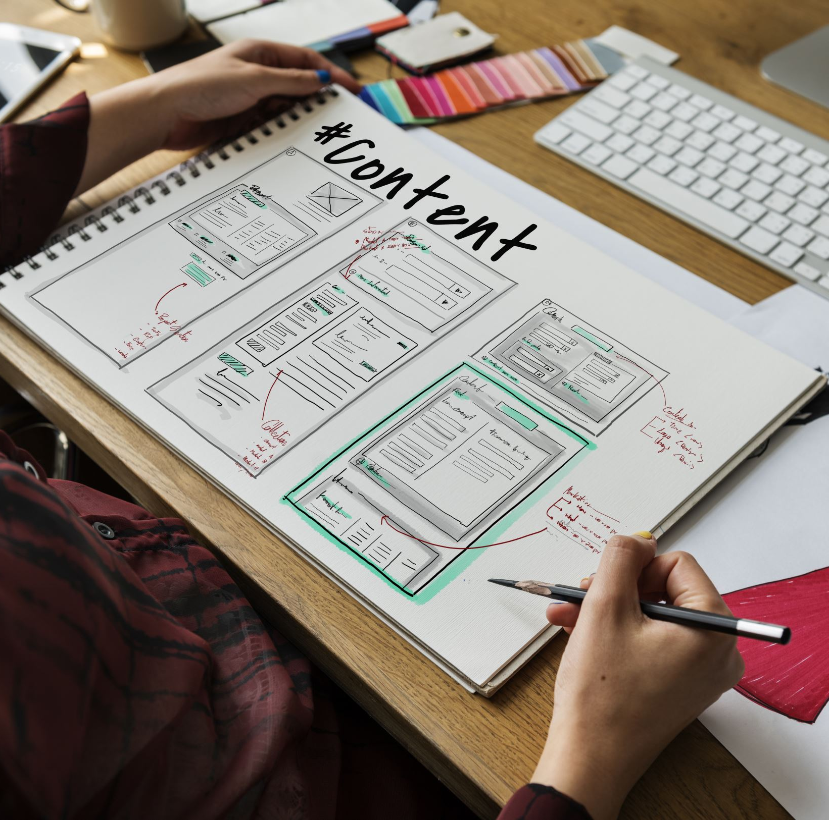
Storyboard exercise

Slide 2
Storyboard Elements
Character: States the user in the storyboard.
Scene: Gives designers a way to imagine the user’s environment.
Plot: Describes the solution or benefit offered by the design.
Narrative: Describes the problem the user is facing and how the design will solve this problem.

Slide 3
Empathy Map
User
Says
Thinks
Does
Feels

Slide 4
Problem Statement
is a
who needs
because
User name
User character
User needs
insight
Source: Google career

Slide 5
Goal Statement
Develop a goal statement. This statement will assist you in defining a storyline (the advantage or solution offered by your design) for your storyboard.

Slide 6
UX Design Storyboard
Scenario:

Slide 7
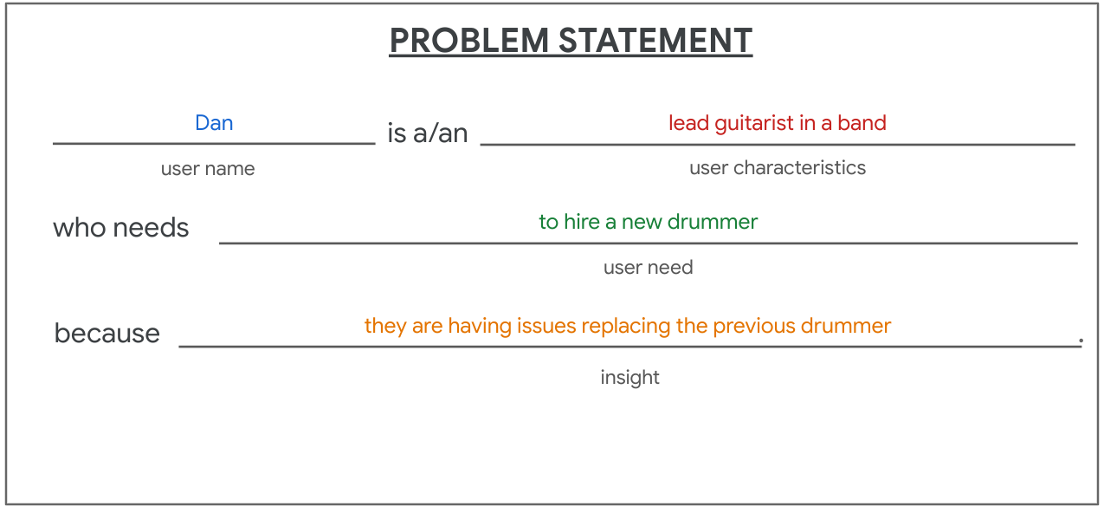
Example: Dan is the lead guitarist of a band that is looking to hire a new drummer due to difficulties in replacing their former drummer.
Source: Medium

Slide 8
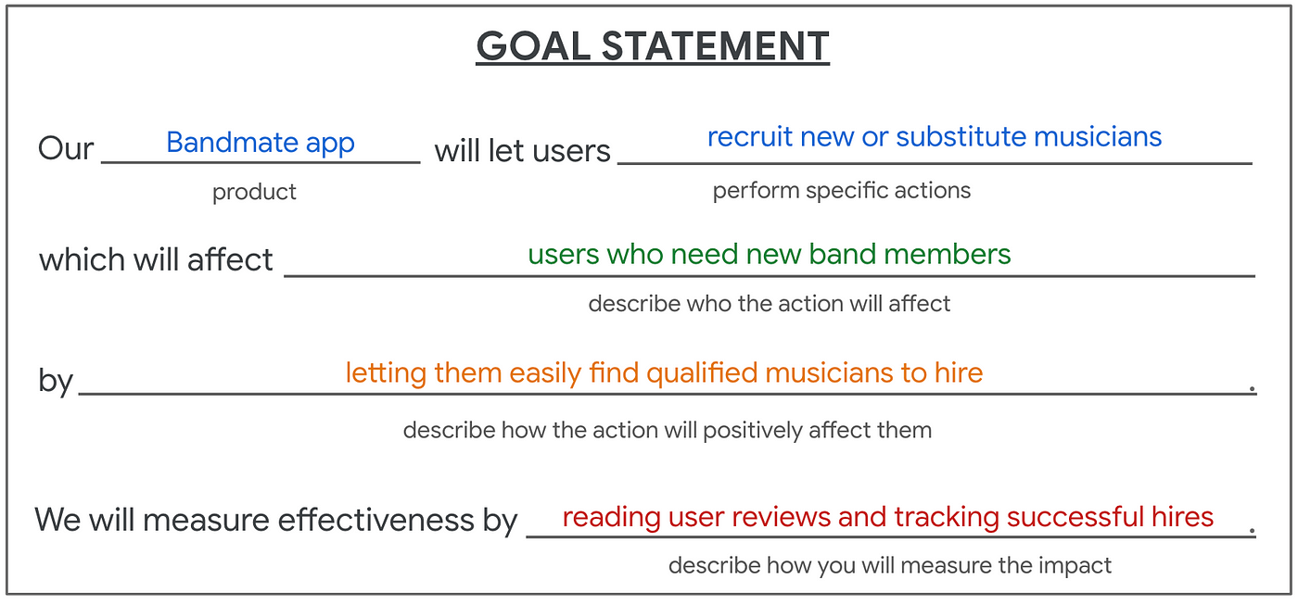
Example: Bandmate app will enable users to recruit new or substitute musicians, benefiting those who require additional band members by simplifying the process of finding qualified musicians to hire. Its effectiveness will be monitored by reviewing user feedback and monitoring successful hires.
Source: Medium

Slide 9
Storyboard Types
Big-picture storyboards emphasize the user's needs, the context in which they operate, and the reasons why the product will be beneficial for them. These storyboards are typically employed early in the design process to help designers gain stakeholder buy-in for their concepts.
On the other hand, close-up storyboards focus on the product itself and its functionality. They are most effective during the middle to later stages of the design process.

Slide 10
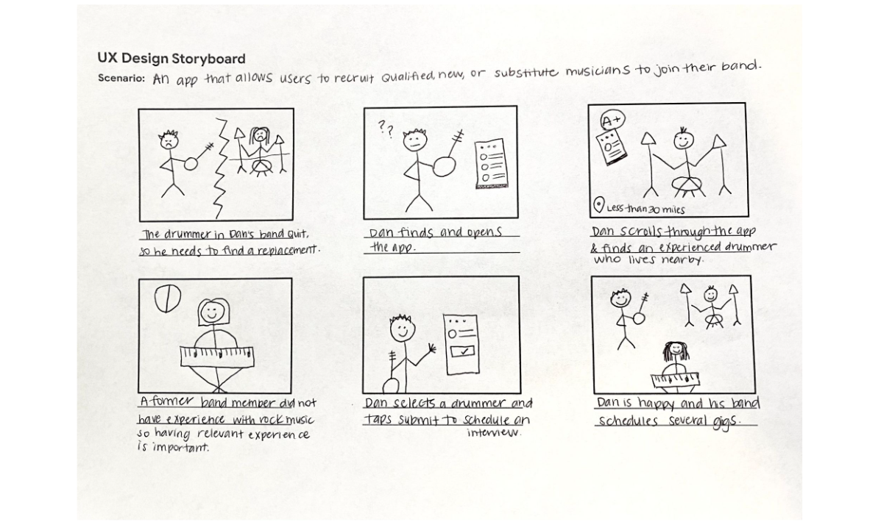
Big-Picture Storyboards
Source: Medium

Slide 11
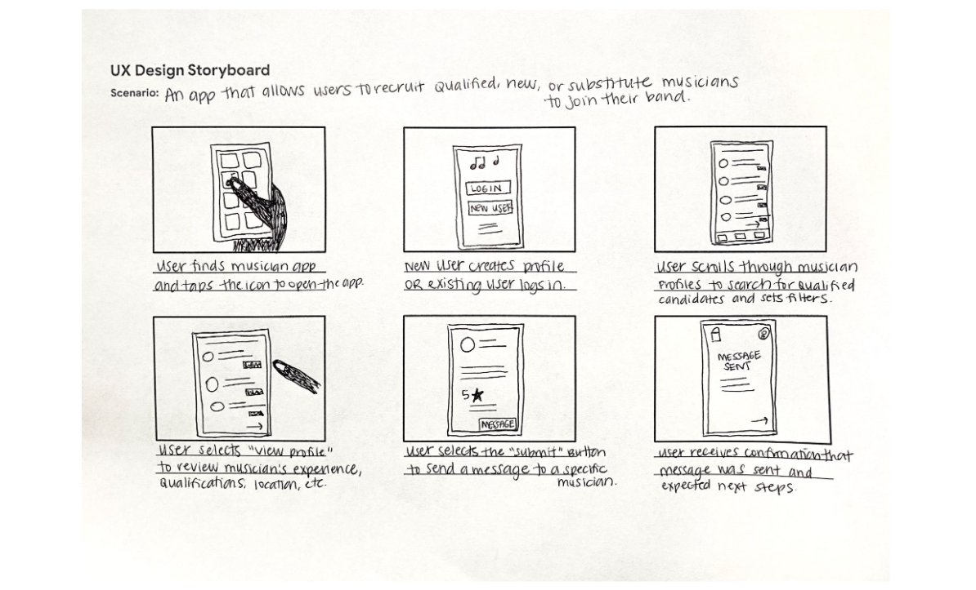
Close-Up Storyboards
Source: Medium

Slide 12
Useful Tutorial
Google Career Certificates

